Slide 1
Case Study
Restaurant:Pizzeria

Slide 2
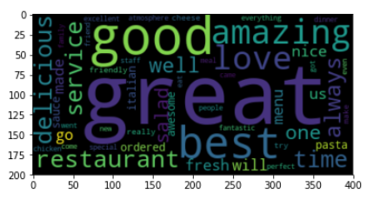
Areas we are doing good
Friendly Staff
Cool atmosphere
Food quality
Image: Wordcloud based on customer reviews

Slide 3
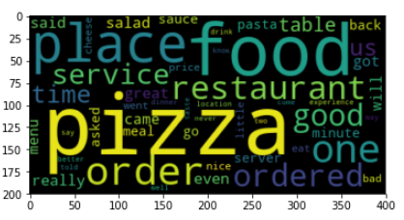
Areas we need to improve
Bar experience
Weekend dinner experience
Item cost
Image: Wordcloud based on customer reviews

Slide 4
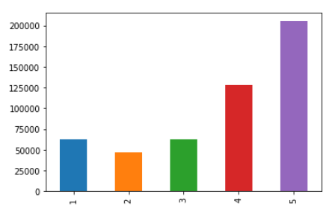
Customer Reviews
Customer v/s reviews in star

Slide 5

Thank you
Any questions? Suggestions?
Good time to shoot.

